Slide 1
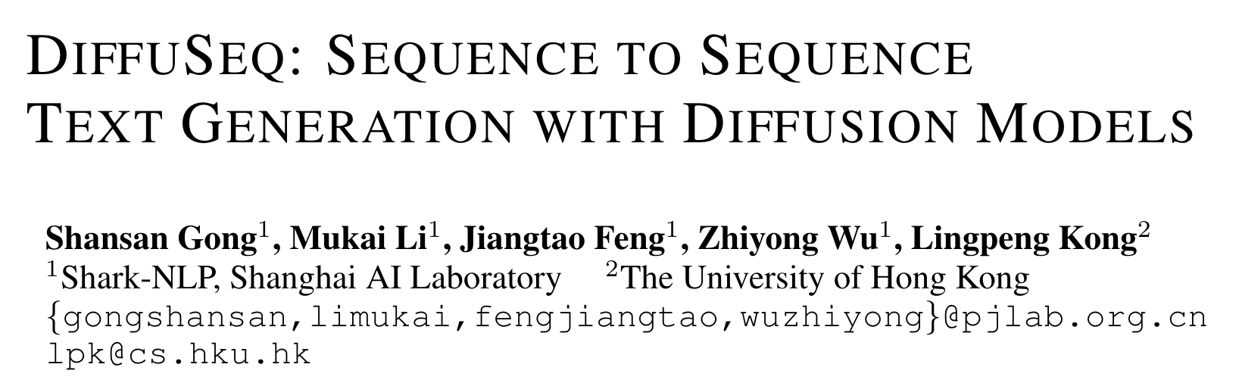
ICLR 2023
董益宏
23.3.20

Slide 2
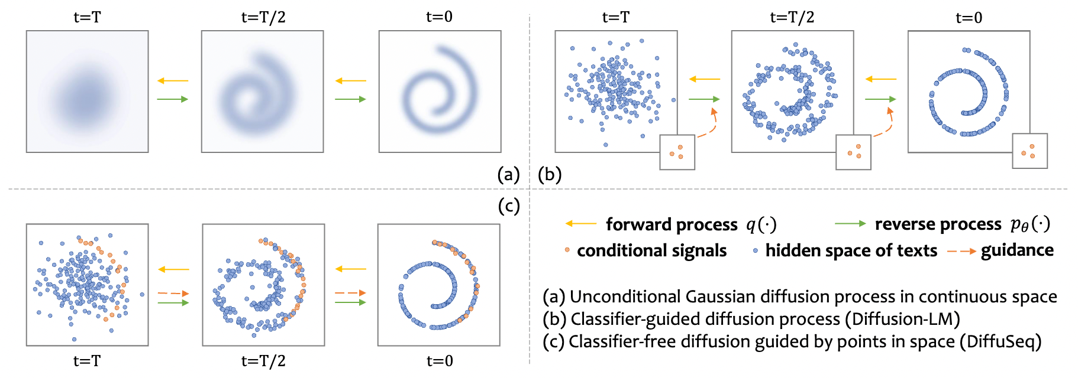
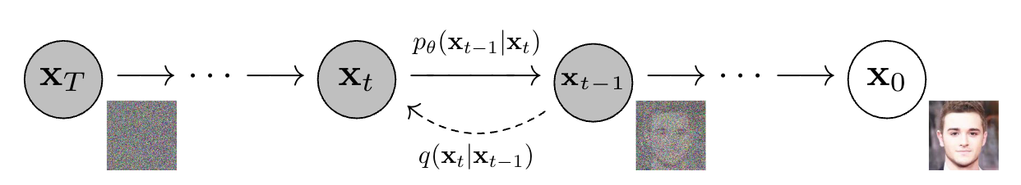
Background
[1]
Unconditional image generation
generating images with no condition in any context (like a prompt text or another image).
[1] Denoising Diffusion Probabilistic Models. NeurIPS2020
Notes:
Diffusion model的开山之作的实验设置是unconditional图片生成，所以diffusion model在文本生成领域最初的探索也是unconditional。

Slide 3
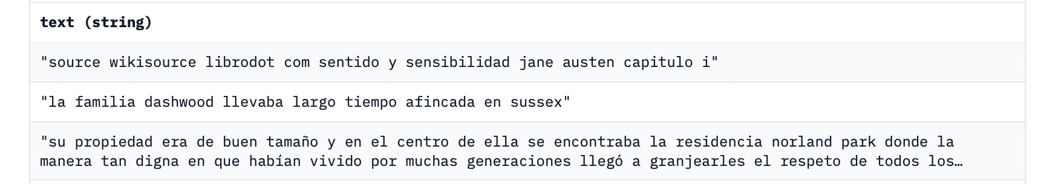
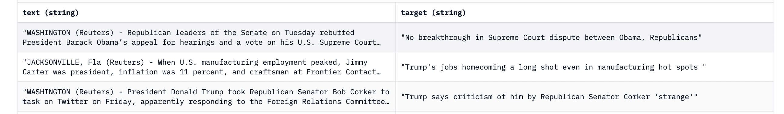
Background
Unconditional text generation
generating texts with no condition in any context (like a prompt text or another text).
Conditional text generation
generating texts with condition in any context (like a prompt text or another text).
Notes:
这边分别展示一下Unconditional和Conditional文本生成的例子，Unconditional文本生成是直接生成text而conditional文本生成是从context来生成标签文本。一般来说，unconditional文本生成用的评估指标是ppl。

Slide 4
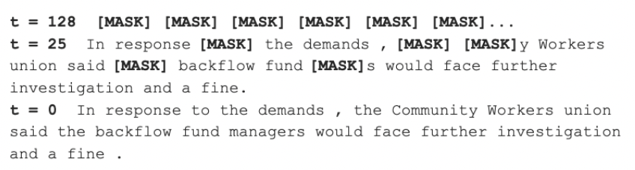
Background
Discrete diffusion model
[2]
[2] Structured Denoising Diffusion Models in Discrete State-Spaces. NeurIPS2021
Notes:
为了让diffusion model应用在离散数据上，谷歌提出了离散扩散模型，思想就是用某种规则把完整的文本句子迭代地mask成初始状态，也就是所有token全部用mask表示，然后让模型学习还原的过程。具体地实施细节可以阅读下面的这篇文章。这种discrete diffusion model只能处理unconditional文本生成。

Slide 5
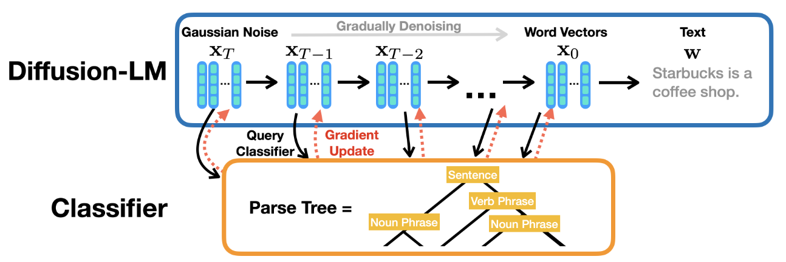
Background
[3]
[3] Diffusion-LM Improves Controllable Text Generation. NeurIPS2022
Notes:
Diffusion-LM解决的是如何将continuous diffusion model应用于条件文本生成（这里的continuous diffusion model也就是最初的扩散模型，为了和discrete diffusion model区分，现在一般被称为continuous diffusion model）。Continuous diffusion model区别于discrete diffusion model，它从gaussian noise生成text而不是mask token。这里Diffusion-LM需要训练一个classifier来引导生成，被称为classifier-guided。

Slide 6
Background
Classifier-free guidance^{[4]}
a technique for guiding diffusion models that does not require a separate classifier model to be trained^{[5]}.
[4] Classifier-free diffusion guidance. NeurIPS2021
[5] GLIDE: Towards Photorealistic Image Generation and Editing with Text-Guided Diffusion Models. ICML2022
Notes:
本文提出的DiffuSeq则希望通过一个模型直接完成条件文本生成，这种生成方式被称为classifier-free。OpenAI使用这种方法将continuous diffusion model应用在text2image的生成上取得了很好的结果，甚至比用预训练的模型当作classifier的效果还好。所以我认为这个文章解决的问题是如何用一个end2end训练的diffusion model来解决条件文本生成。

Slide 7
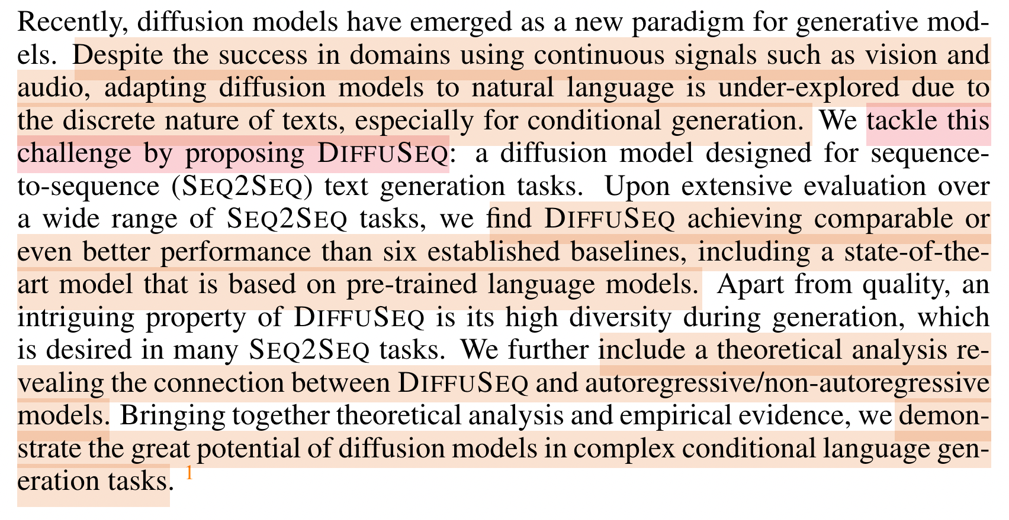
Abstract
Notes:
我们来看一下这篇文章摘要，首先作者认为diffusion model是生成模型的一种新的范式，这篇文章想解决的挑战就是如何让diffusion model适应条件文本生成（classifier-free diffusion model），然后实验表明DiffuSeq的效果很好，甚至比基于pre-trained LM还要好。他们还理论分析了DIFFUSEQ 和自回归/非自回归模型之间联系。实结果验和理论分析展示了扩散模型在复杂条件语言生成任务中的巨大潜力。

Slide 8
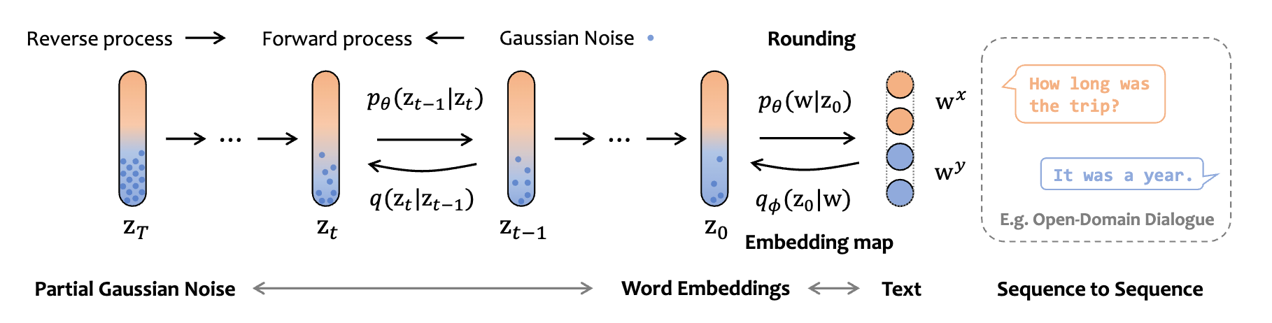
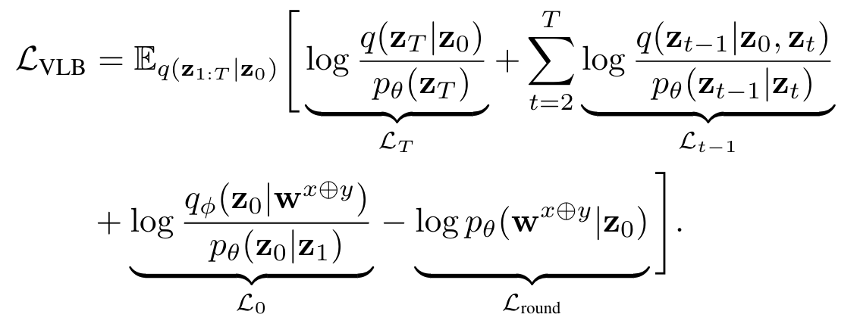
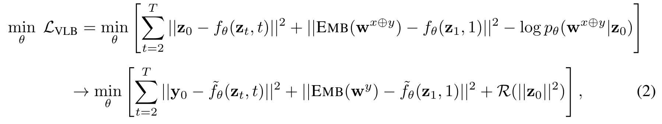
DIFFUSEQ
Notes:
我们先看损失函数是怎么来的，它其实是用了Diffusion-LM的设定。

Slide 9
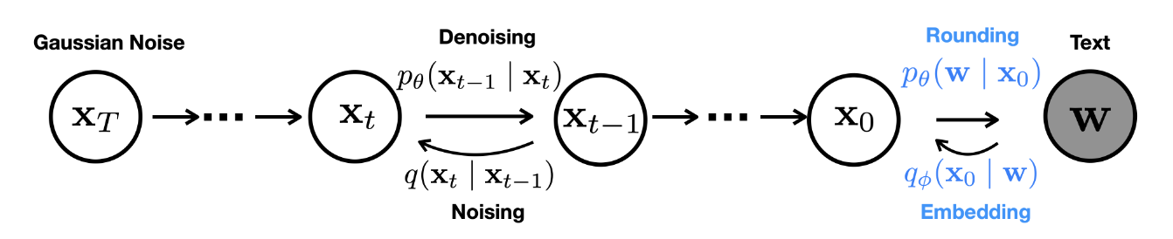
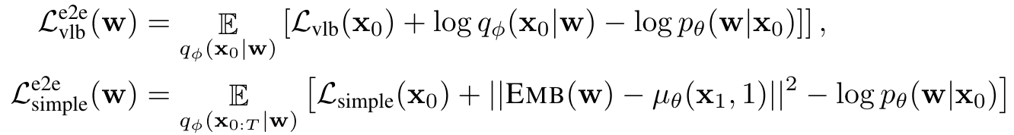
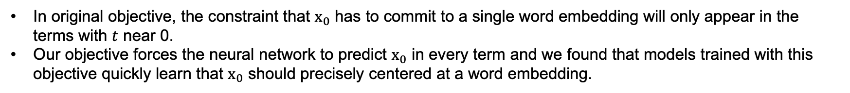
Diffusion-LM
instead of
In original objective, the constraint that $x_{0}$ has to commit to a single word embedding will only appear in the terms with $t$ near 0.
Our objective forces the neural network to predict $x_{0}$ in every term and we found that models trained with this objective quickly learn that $x_{0}$ should precisely centered at a word embedding.
Notes:
这部分张煌昭学长和泽钧都讲过，我这里回顾一下。在最初的diffusion model里，损失函数是被定义成这样的，可以理解为它希望神经网络估计的噪声和加原先加噪的噪声越接近越好。

Slide 10
Diffusion-LM
instead of
In original objective, the constraint that $x_{0}$ has to commit to a single word embedding will only appear in the terms with $t$ near 0.
Our objective forces the neural network to predict $x_{0}$ in every term and we found that models trained with this objective quickly learn that $x_{0}$ should precisely centered at a word embedding.
Notes:
Diffusion-LM在原损失函数的基础上加上了Embedding和Rounding的部分。

Slide 11
Diffusion-LM
instead of
In original objective, the constraint that $x_{0}$ has to commit to a single word embedding will only appear in the terms with $t$ near 0.
Our objective forces the neural network to predict $x_{0}$ in every term and we found that models trained with this objective quickly learn that $x_{0}$ should precisely centered at a word embedding.
Notes:
并且它还修改了Denoising和Nosing的部分，迫使神经网络在每个Loss中预测 x_0，原因是用这个Loss训练的模型预测的x_0 可以更精确地Rounding到词向量。

Slide 12
DIFFUSEQ
Notes:
原先的x在这里对应着z，这篇文章的改动很简单，原本学习的是对整个文本noising和denoising的过程，现在学习对y noising和denoising的过程。这里x指的是输入也就是condition，y指的是给定condition需要生成的输出。

Slide 13
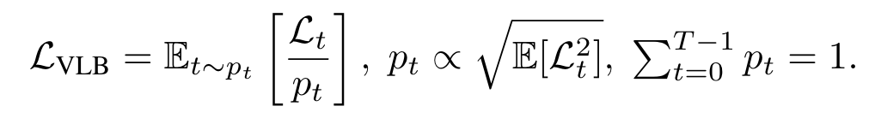
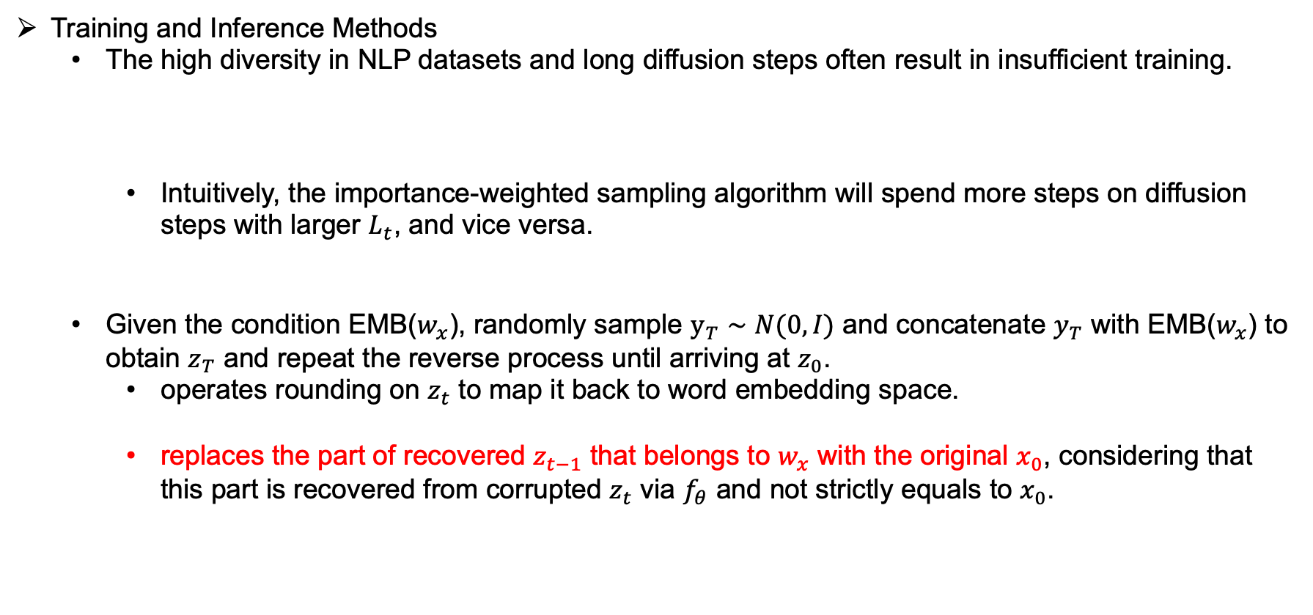
DIFFUSEQ
Training and Inference Methods
The high diversity in NLP datasets and long diffusion steps often result in insufficient training.
Intuitively, the importance-weighted sampling algorithm will spend more steps on diffusion steps with larger $L_{t}$, and vice versa.
Given the condition EMB($w_{x}$), randomly sample $y_{T}∼N(0,I)$ and concatenate $y_{T}$ with EMB($w_{x}$) to obtain $z_{T}$ and repeat the reverse process until arriving at $z_{0}$.
operates rounding on $z_{t}$ to map it back to word embedding space.
replaces the part of recovered $z_{t−1}$ that belongs to $w_{x}$ with the original $x_{0}$, considering that this part is recovered from corrupted $z_{t}$ via $f_{θ}$ and not strictly equals to $x_{0}$.
Notes:
Diffusion-LM
训练和推理方法
NLP 数据集的高度多样性和长扩散步骤通常会导致训练不足。
直观上，重要性加权采样算法会在𝐿_𝑡较大的扩散步骤上花费更多的步骤，反之亦然。
给定条件 EMB(𝑤_𝑥)，随机采样 y_𝑇∼𝑁(0,𝐼) 并将𝑦_𝑇 与 EMB(𝑤_𝑥) 连接以获得𝑧_𝑇 并重复相反的过程直到到达𝑧_0。
对𝑧_𝑡 进行舍入以将其映射回词嵌入空间。
将恢复的𝑧_(𝑡−1)中属于𝑤_𝑥的部分替换为原来的𝑥_0。

Slide 14
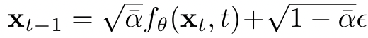
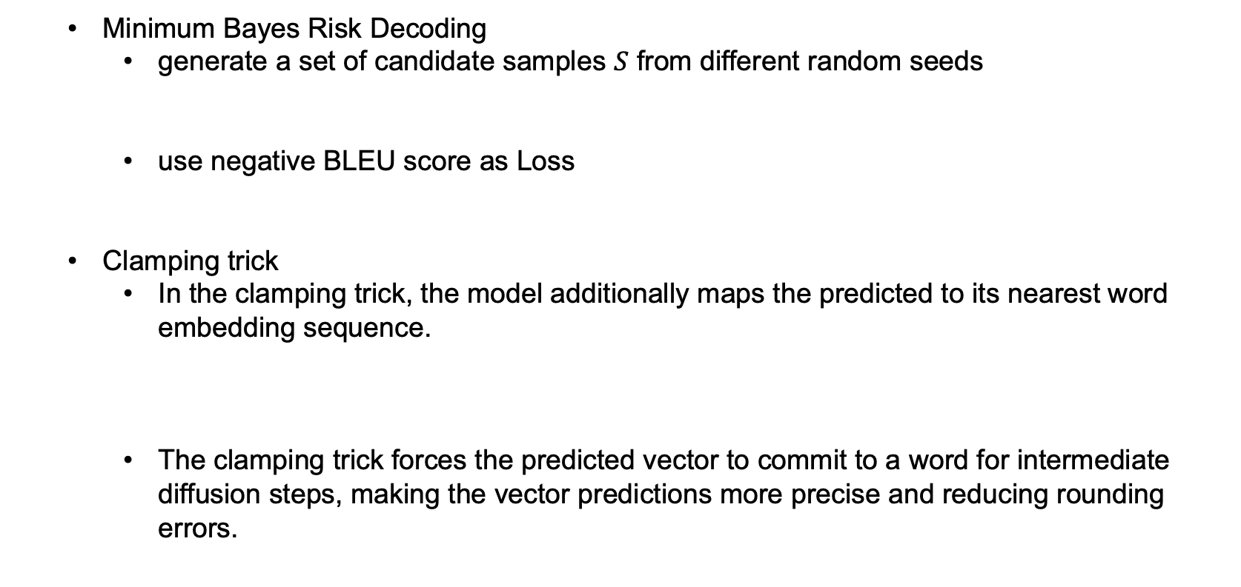
DIFFUSEQ
Minimum Bayes Risk Decoding
generate a set of candidate samples $S$ from different random seeds
use negative BLEU score as Loss
Clamping trick
In the clamping trick, the model additionally maps the predicted to its nearest word embedding sequence.
The clamping trick forces the predicted vector to commit to a word for intermediate diffusion steps, making the vector predictions more precise and reducing rounding errors.
Notes:
最小贝叶斯风险解码
从不同的随机种子生成一组候选样本𝑆
在Clamping技巧中，该模型另外将预测映射到其最近的词嵌入序列。
Clamping技巧强制预测向量在中间扩散步骤中使用一个词，使向量预测更加精确并减少舍入误差。

Slide 15
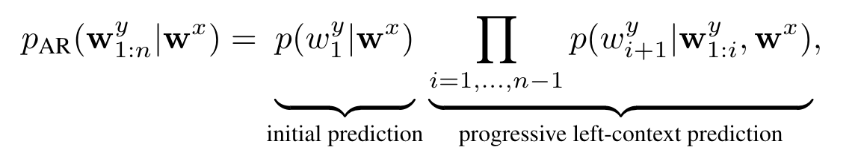
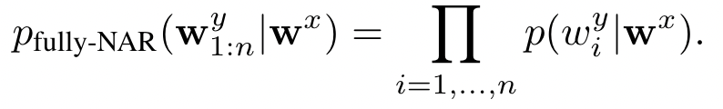
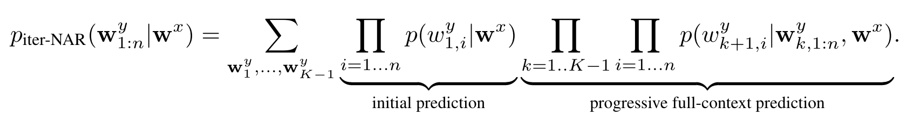
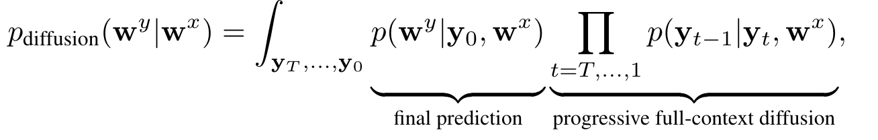
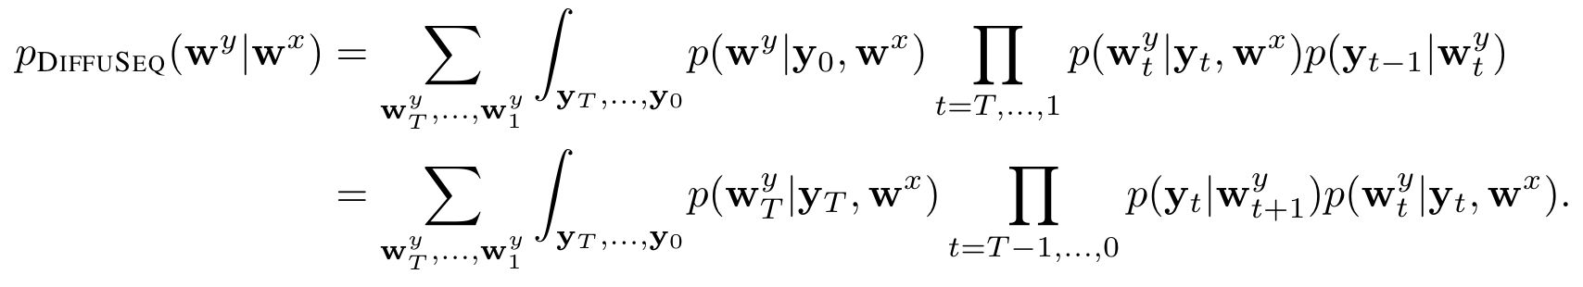
DIFFUSEQ
Connections to AR, Iter-NAR, and Fully-NAR Models

Slide 16
Experimental Setup
Tasks and Datasets
Open domain dialogue
generate informative responses given a dialogue context.
Commonsense Conversation Dataset (3 million conversational pairs)
Question generation
generate questions given a context as input.
Quasar-T (119K document-question pairs)
Text simplification
revise the complex text into sequences with simplified grammar and word choice.
a corpus consisting of 677K complex-simple sentences with revision alignment
Paraphrase
generate an alternative surface form in the same language expressing the same semantic content.
QQP (147K positive pairs)
Baselines
AR
Training: GRU with attention and Transformer
Finetuning: GPT2 and GPVAE
NAR
LevT (a widely used, strong iterative NAR mode)
Notes:
任务和数据集
开放领域对话
在给定对话上下文的情况下生成信息丰富的响应。
Commonsense Conversation 数据集（300 万个对话对）
问题生成
在给定上下文作为输入的情况下生成问题。
Quasar-T（119K 文档-问题对）
文本简化
将复杂的文本修改为具有简化语法和单词选择的序列。
一个由 677K 个复杂-简单句子组成的语料库，具有修订对齐
释义
用相同的语言生成替代的表面形式来表达相同的语义内容。
QQP（147K 正对）
基线
AR
训练：GRU with attention 和 Transformer
微调：GPT2 和 GPVAE
NAR
LevT（一种广泛使用的强迭代NAR模式）

Slide 17
Experimental Setup
Evaluation
Quality
Higher scores of BLEU, ROUGE-L and BERTScore reflect better performance.
Diversity
The lower dist-1 indicates that the generated sentence contains more repeated words.
The lower self-BLEU and higher div-4 suggest higher diversity of generation.
Implementation Details
DIFFUSEQ is based on the 12 layers of Transformer with 12 attention heads, where the time step embedding is plugged akin to the position embedding.
The maximum sequence length is 128, with embedding dimension d = 128, diffusion steps T = 2,000 and a square-root noise schedule.
apply Byte Pair Encoding to construct the vocabulary and diversity beam search (DBS) to sample.
compute the accuracy metrics of DIFFUSEQ using MBR with the size of candidate samples |S| = 10.
The experiment is deployed on NVIDIA A100 Tensor Core GPUs, and we use 4 GPUs on training and single GPU on sampling.
Notes:
评估
质量
BLEU、ROUGE 和 BERTScore 得分越高，性能越好。
多样性
较低的 dist-1 表示生成的句子包含更多重复的单词。
较低的 self-BLEU 和较高的 div-4 表明生成的多样性较高。
实施细节
DIFFUSEQ 基于具有 12 个注意力头的 12 层 Transformer，其中时间步长嵌入类似于位置嵌入。
最大序列长度为 128，嵌入维度 d = 128，扩散步骤 T = 2,000 和平方根噪声时间表。
应用字节对编码构建词汇表和多样性集束搜索（DBS）进行采样。
使用具有候选样本大小的 MBR 计算 DIFFUSEQ 的准确度指标 |S| = 10。
实验部署在 NVIDIA A100 Tensor Core GPU 上，我们使用 4 个 GPU 进行训练，使用单个 GPU 进行采样。

Slide 18
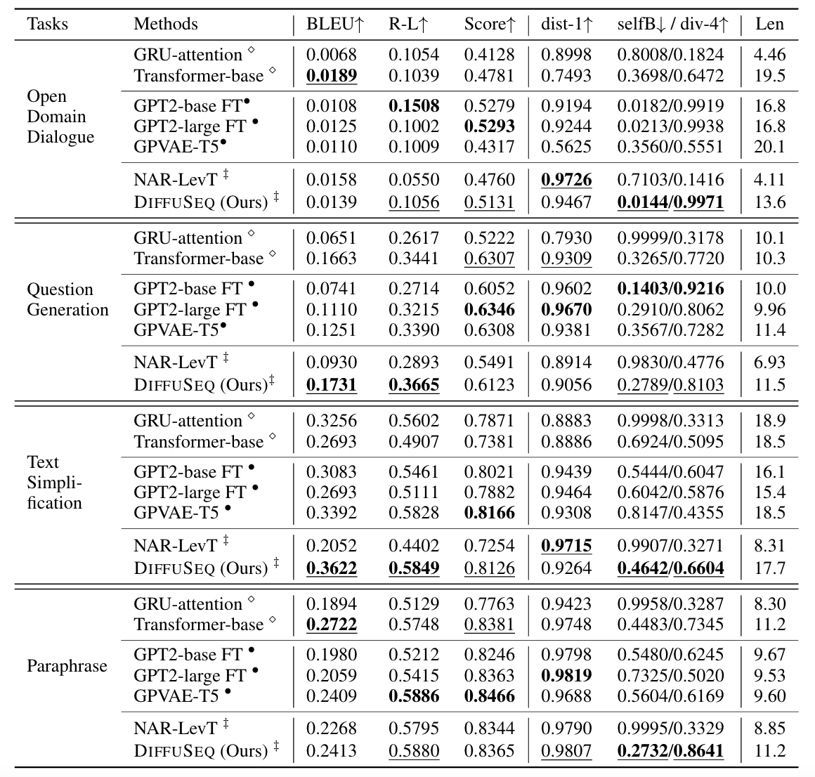
Experiments

Slide 19
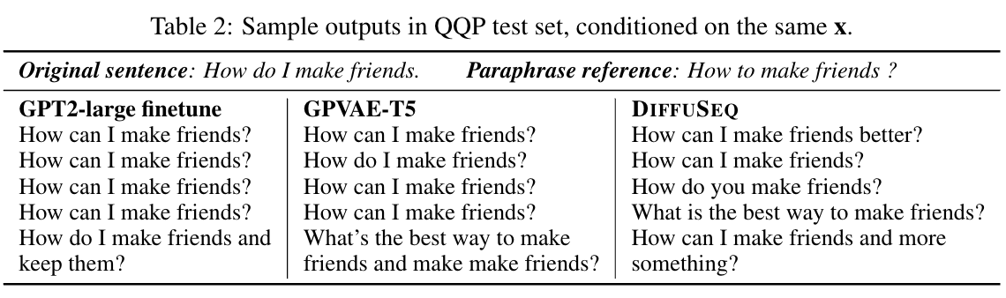
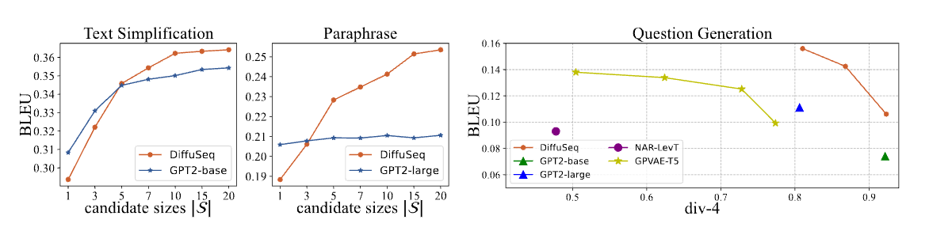
Experiments
Notes:
Trade-off between quality and diversity

Slide 20
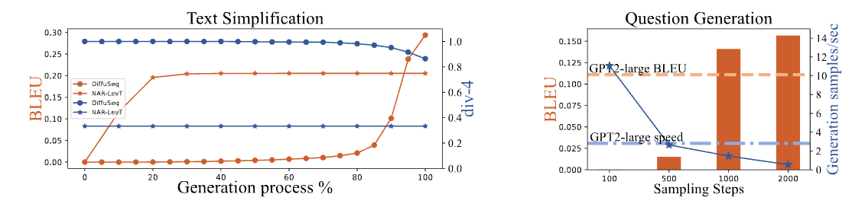
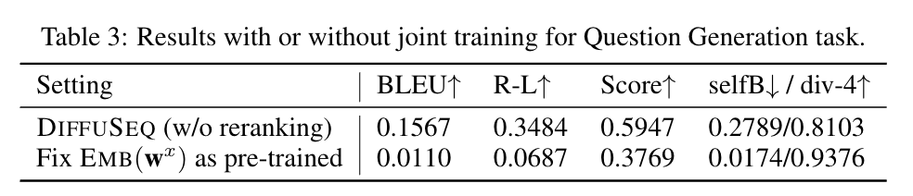
Experiments
Notes:
LevT 在生成之BLEU急剧增长，并在后续的过程中迅速减慢。但DIFFUSEQ表现不同，BLEU分数一开始增长缓慢，随着扩散过程的进行迅速增加，最终超过LevT。LevT 和 DIFFUSEQ 的多样性都是在很早的阶段确定的，其中 DIFFUSEQ 在生成的任何阶段在多样性方面始终优于 LevT。 DIFFUSEQ 在生成过程的前半部分探索更多可能的结果，并在步骤结束时很快收敛到几个潜在的候选者。
当在单个 GPU 上将推理减少到 1,000 个扩散步骤时，DIFFUSEQ 获得了比 GPT2-large 更高的 BLEU 分数，但推理速度更接近 GPT2-large

Slide 21
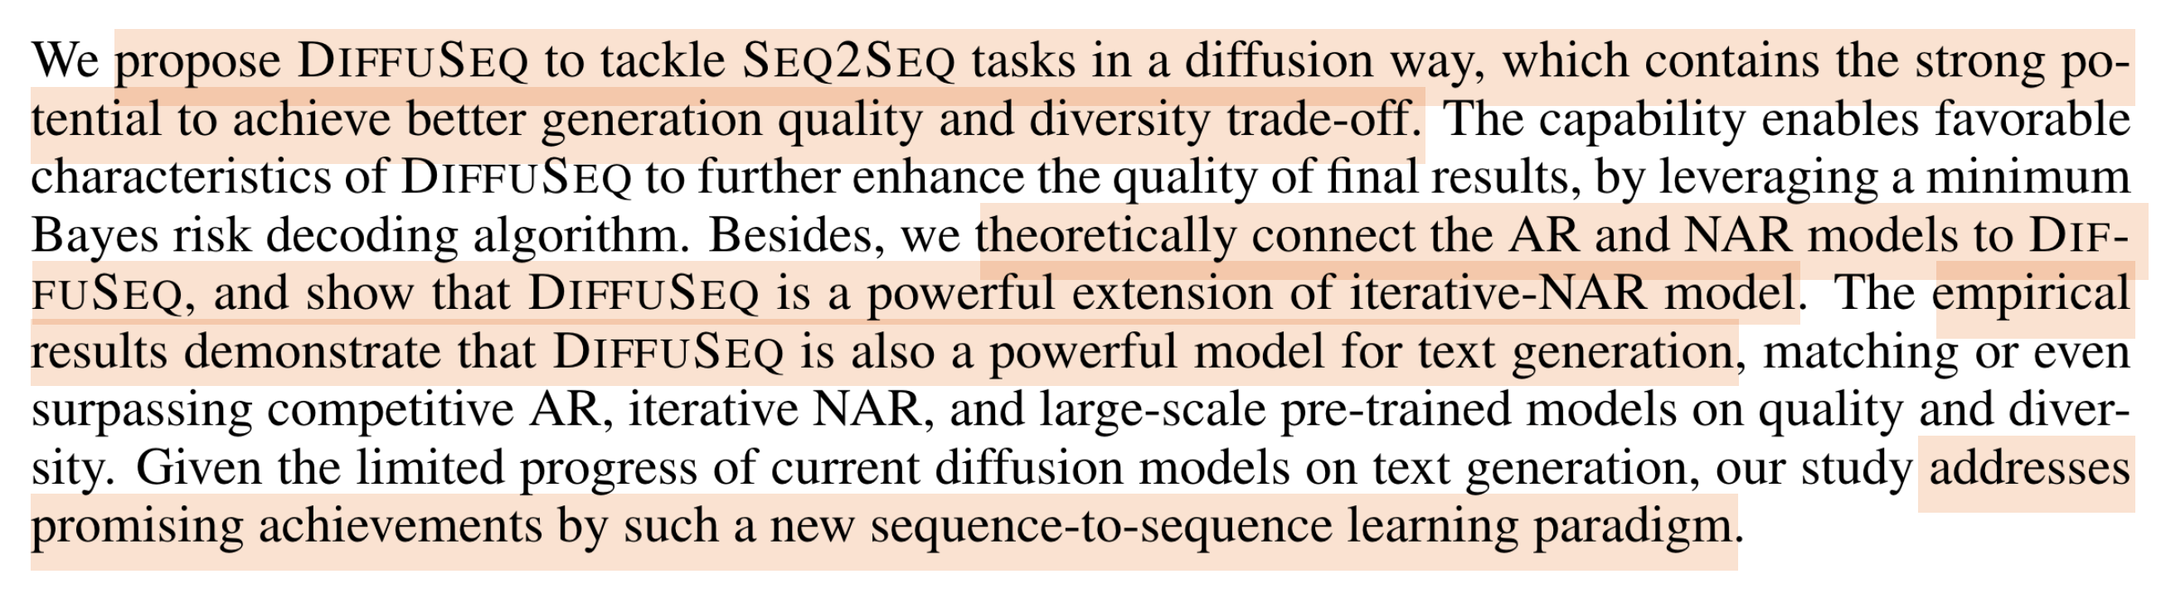
Conclusion
Notes:
总结一下：
这篇文章提出 DIFFUSEQ 以扩散方式来处理Seq2Seq任务，这种方法在生成质量和多样性权衡方面有强大的潜力。利用MBR算法，使 DIFFUSEQ 能够进一步提高最终结果的质量。
从理论上证明了DIFFUSEQ 是 iterative-NAR 模型的强大扩展，并且实验结果表明，DIFFUSEQ 是一个强大的文本生成模型。
提出了一种有前景的Seq2Seq learning的范式。
我个人认为这篇文章解决的才是我们认知上的文本生成，以前的工作可能在实际上并没有太大的应用价值。

Slide 22
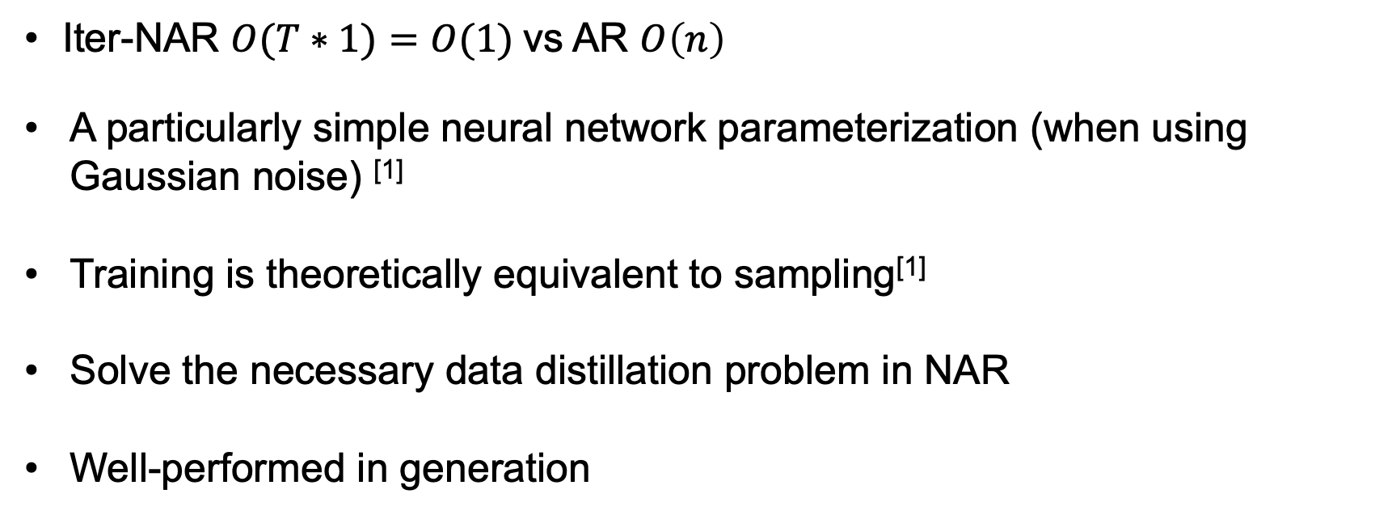
Motivation- Diffusion model
Iter-NAR $O(T∗1)=O(1)$vs AR $O\left(n\right)$
A particularly simple neural network parameterization (when using Gaussian noise) ^{[1]}
Training is theoretically equivalent to sampling^{[1]}
Solve the necessary data distillation problem in NAR
Well-performed in generation

Slide 23
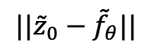
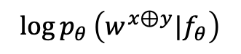
Improvements
/add
$${||\tilde{z}}_{0}−{\tilde{f}}_{θ}||$$
$$\log{p_{θ}}\left(w^{x⊕y}|f_{θ}\right)$$
Clamp with PDA for code generation

Slide 24
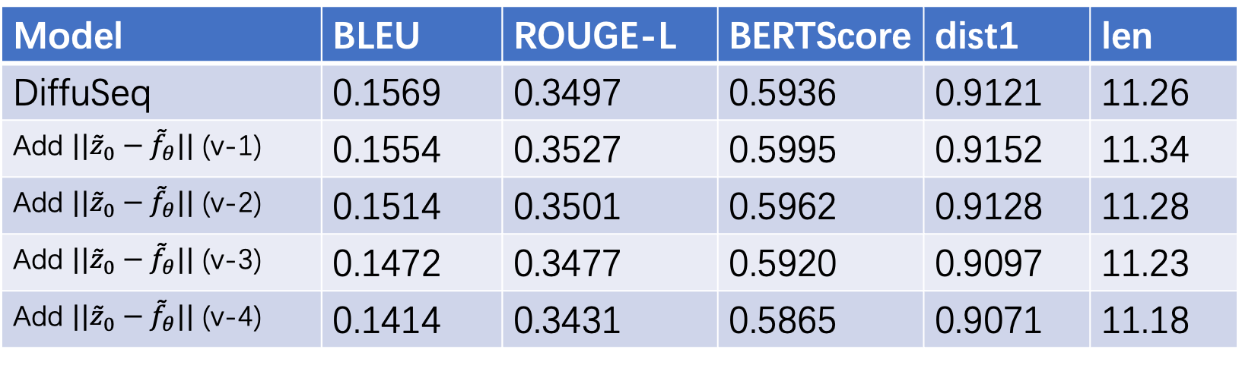
Experiment results on Question Generation
Model | BLEU | ROUGE-L | BERTScore | dist1 | len
DiffuSeq | 0.1569 | 0.3497 | 0.5936 | 0.9121 | 11.26
Add ${||\tilde{z}}_{0}−{\tilde{f}}_{θ}||$ (v-1) | 0.1554 | 0.3527 | 0.5995 | 0.9152 | 11.34
Add ${||\tilde{z}}_{0}−{\tilde{f}}_{θ}||$ (v-2) | 0.1514 | 0.3501 | 0.5962 | 0.9128 | 11.28
Add ${||\tilde{z}}_{0}−{\tilde{f}}_{θ}||$ (v-3) | 0.1472 | 0.3477 | 0.5920 | 0.9097 | 11.23
Add ${||\tilde{z}}_{0}−{\tilde{f}}_{θ}||$ (v-4) | 0.1414 | 0.3431 | 0.5865 | 0.9071 | 11.18

